Slide 1
Media To-Do List App
“Tag Team”: Ally Hays, Charles Myers, Faith Coslett, Joshua Malone

Slide 2
Team Introduction
Allyson Hays - Frontend
Faith Coslett - Backend
Joshua Malone - Database
Charles Myers - Database
All Computer Science majors

Slide 3

Motivation and Concept
Amount of media today is overwhelming
“Decision fatigue”
Endlessly scrolling Netflix
Easy to lose track of things you want to check out later

Slide 4
Motivation and Concept
Existing apps only specialize in one type of media
Helpful to have a central app with all media in one place
Custom tags keep your list organized
Tag filtering lets you quickly find what you’re in the mood for

Slide 5


Proposed Design
Cross-platform app
Dart/Flutter framework
Works on Android, iPhone, Windows, Mac, Linux, + web
User-generated database

Slide 6
Proposed Design
Each media entry contains its title, type, length, genre, + any other notes or properties user wants
User can add, edit, delete, search, and filter entries
Filtering of custom tags lets user find media fast

Slide 7
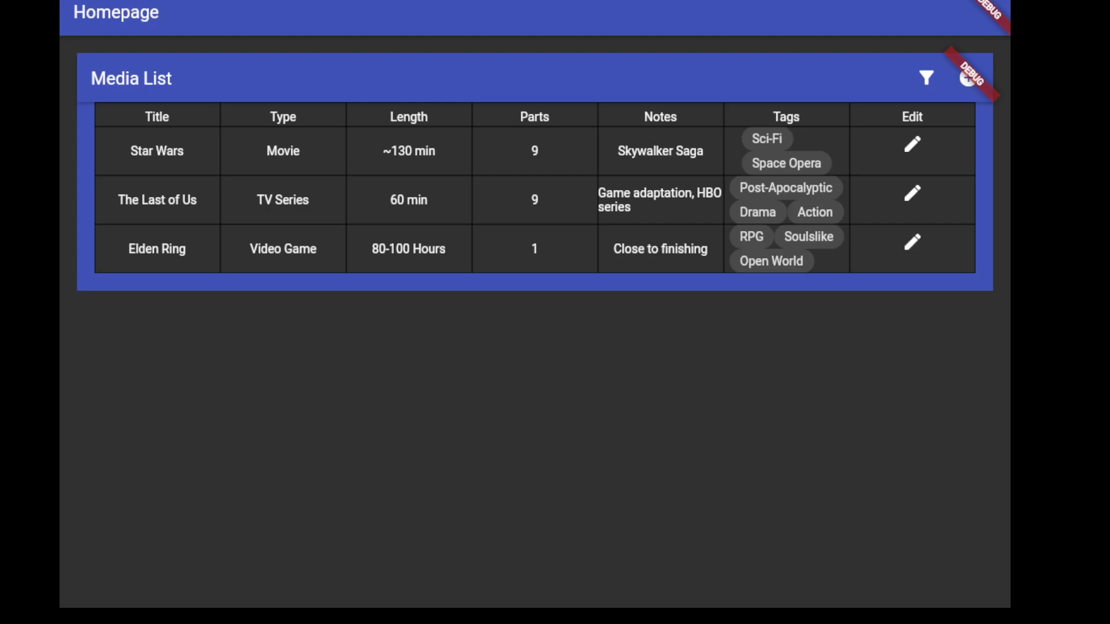
Final Product – Main Page

Slide 8
Final Product – Add

Slide 9
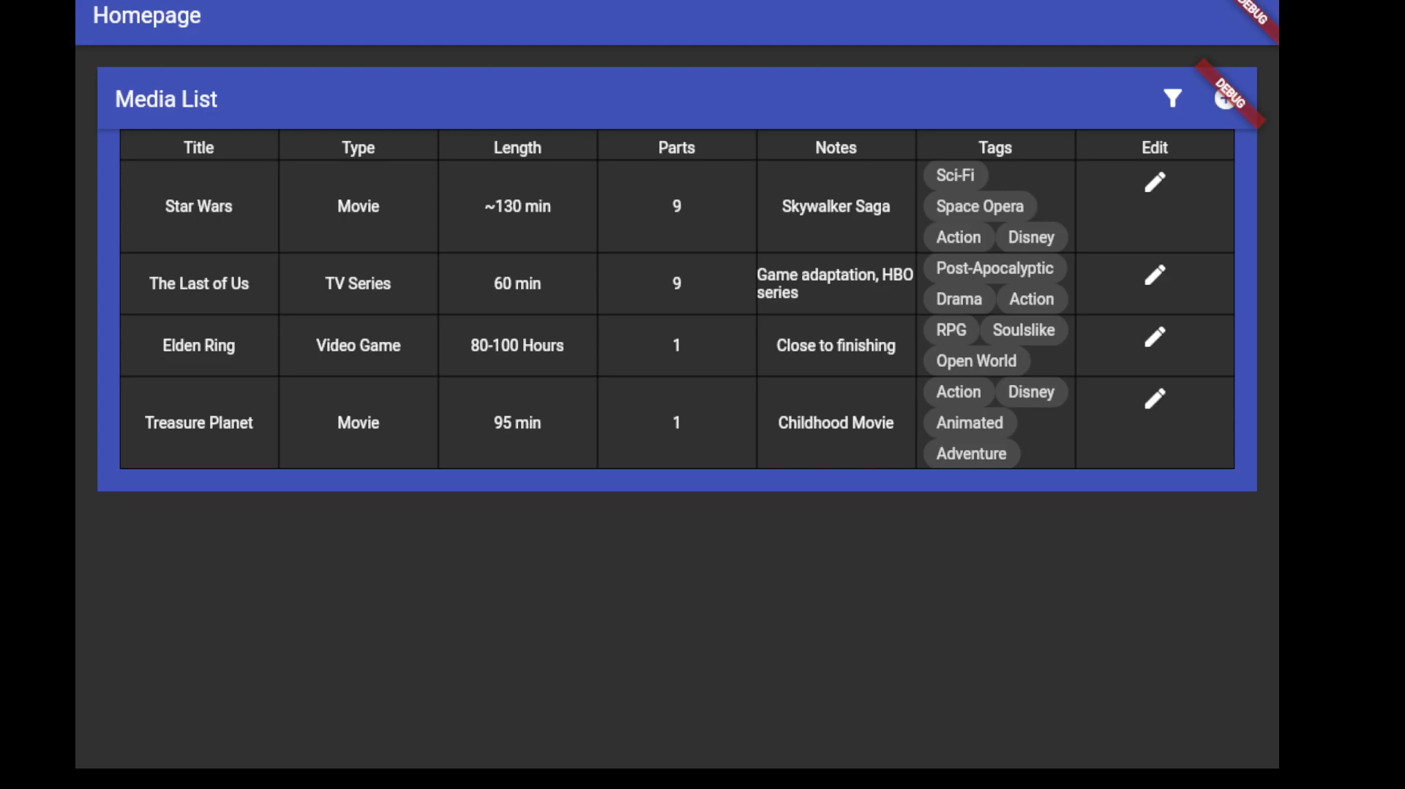
Final Product – Delete

Slide 10
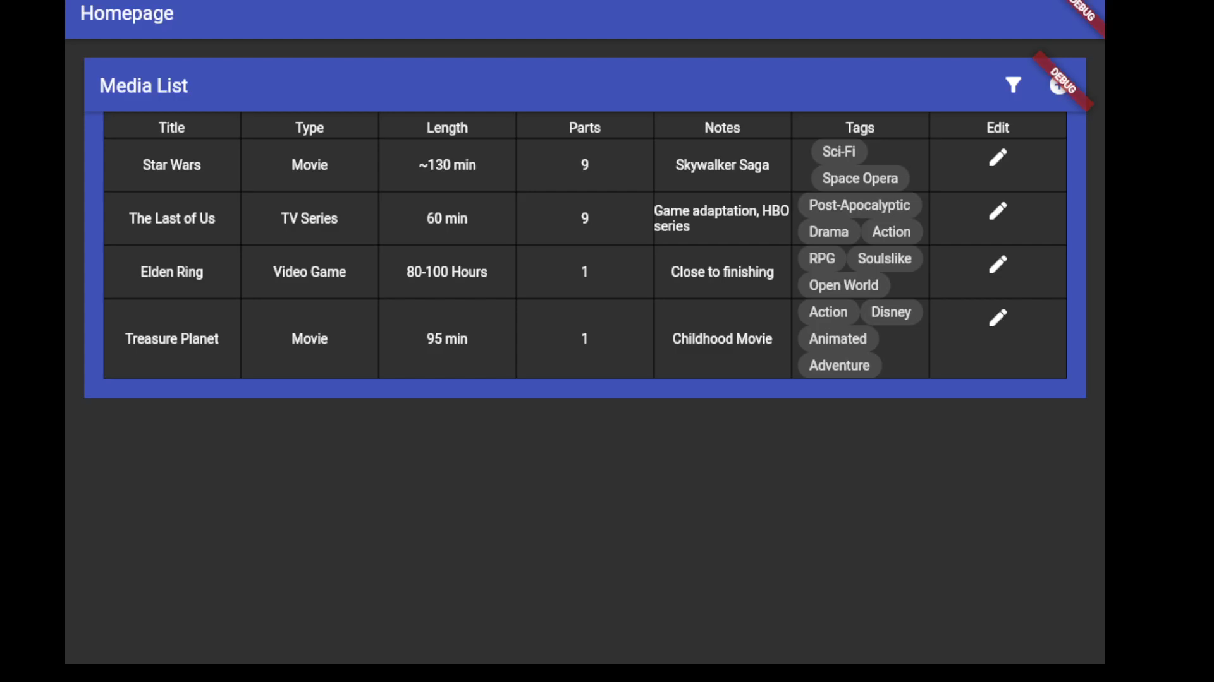
Final Product – Edit

Slide 11
Final Product – Filter Tags

Slide 12
Final Product – Search Title

Slide 13

Challenges and Solutions
No prior flutter experience
Our combined skills are able to make this happen.
Varying and busy schedules
Regular open communication via discord.
Group discord helped us to stay up to date on updates and issues with the project.

Slide 14
Challenges and Solutions
Late in project, realized planned SQL database would not work on web platform
Picked new one from limited options with web compatibility and okay documentation.
Working together over discord helps us find solutions faster.
Parallel work difficult due to widgets and their functions being in 1 spot in 1 file.
We tended to work on one thing at a time and communicated what we were adding so that it was easy to add and modify new things.
Working with whoever was programming at the time in discord to arrive at solutions faster.

Slide 15

Conclusion
Achieved goal of functioning media to-do app
Cross-platform, user-driven, customizable
Future work:
Polish look of app
Include more default tags for user convenience
Let user create sublists, not just single big one

Slide 16
Conclusion
Lessons learned:
Start work early, reduces future setbacks from surprises
Check + test compatibility before extensive designing
Open group communication is key

Slide 17

Q/A

